Slide 1




PROBLEM SOLVING PROCESS
Class X
lab 5

Slide 2
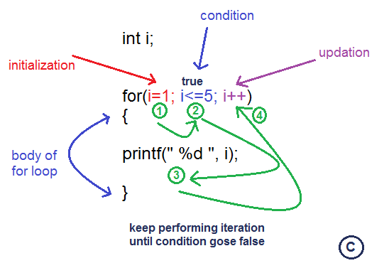
for loop
a for-loop is a control
flow statement for
specifying iteration

Slide 3
Syntax of for Loop
for val in sequence: Body of for

Slide 4
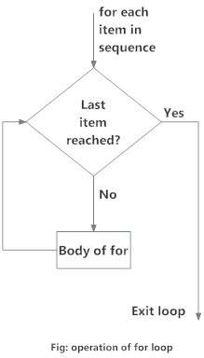
Flowchart of for Loop

Slide 5
Example: for Loop
# Program to find the sum of all numbers stored in a list
# List of numbers
numbers = [6, 5, 3, 8, 4, 2, 5, 4, 11]
# variable to store the sum
sum = 0
# iterate over the list
for val in numbers:
sum = sum+val
# Output: The sum is 48
print("The sum is", sum)

Slide 6
The range() function
# Output: range(0, 10)
print(range(10))
We can generate a sequence of numbers using range() function. range(10) will generate numbers from 0 to 9 (10 numbers).

Slide 7



